Slide 1
SECURE DATA HIDING IN IMAGES USING STEGANOGRAPHY
CAPSTONE PROJECT
Student Name : DAKSHINA MOORTHY N D
College Name & Department : Saveetha Engineering College & AI&DS

Slide 2
OUTLINE
Problem Statement
Technology used
Wow factor
End users
Result
Conclusion
Git-hub Link
Future scope

Slide 3
Problem Statement
Problem Statement: In an increasingly digital world, securing sensitive information during transmission is paramount. Traditional encryption methods may attract attention and raise suspicion, making covert communication challenging. This project explores the use of steganography to hide data within images, aiming to develop a method that ensures data confidentiality and integrity while remaining imperceptible to unauthorized users. The goal is to implement a robust and efficient data-hiding technique that enhances the security of digital communication.

Slide 4
Technology used
Technologies:
Python: A popular programming language for implementing steganography algorithms.
Cryptography Libraries: For encrypting data before embedding it into images.
Libraries:
Pillow: A Python Imaging Library (PIL) fork that supports opening, manipulating, and saving many different image file formats.
OpenCV: An open-source computer vision and machine learning software library, useful for image processing tasks.
Stegano: A Python library specifically designed for steganography, providing easy-to-use functions for hiding and extracting data.
Crypto: A Python library for cryptographic operations, such as AES encryption.
Platforms:
Jupyter Notebook: An open-source web application for creating and sharing documents with live code, equations, visualizations, and narrative text.
GitHub: For version control and collaboration, allowing you to manage your project's codebase and collaborate with others.

Slide 5
Wow factors
Advanced Encryption: Combining steganography with robust encryption techniques (e.g., AES-256) to ensure an additional layer of security for the hidden data.
Adaptive Embedding: Using an intelligent algorithm to adaptively choose the best pixels for embedding data, minimizing the risk of detection and preserving image quality.
User-Friendly Interface: Developing a sleek, intuitive GUI that allows users to easily hide and extract data without needing extensive technical knowledge.
Multi-Format Support: Enabling data embedding not only in images but also in other media formats like audio and video, broadening the scope of the project.
Error Detection and Correction: Implementing mechanisms to detect and correct errors in the hidden data, ensuring data integrity even if the carrier media is altered.

Slide 6
End users
Security Professionals: Individuals and organizations focused on cybersecurity who need to securely transmit sensitive information.
Journalists and Activists: Those working in regions where freedom of expression is restricted may use steganography to covertly share information.
Intellectual Property Owners: Companies or individuals who want to protect their digital content from unauthorized use by embedding watermarks.
Government Agencies: For secure communication and protection of sensitive data.
General Consumers: Tech-savvy individuals who value privacy and want to ensure their personal data is secure during transmission.

Slide 7
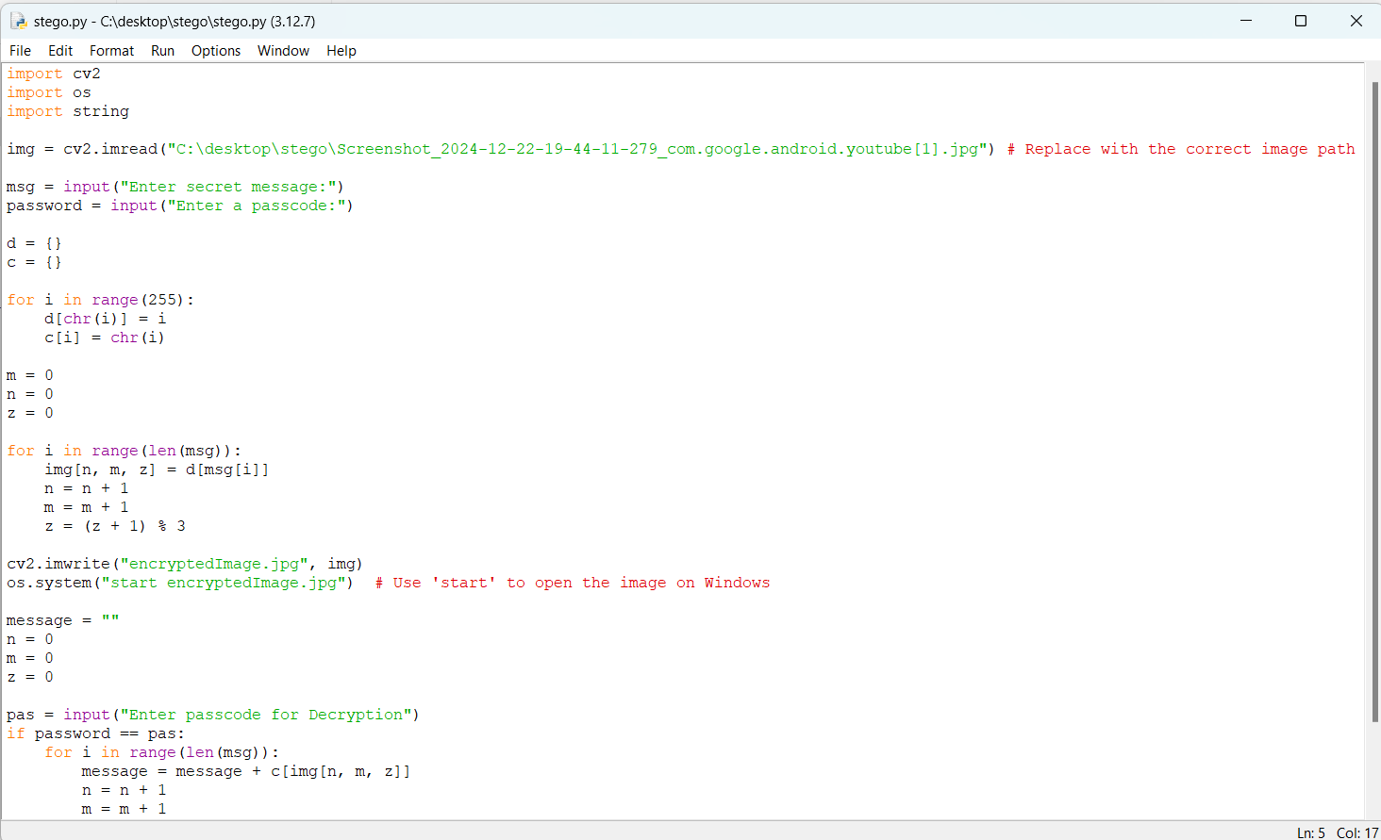
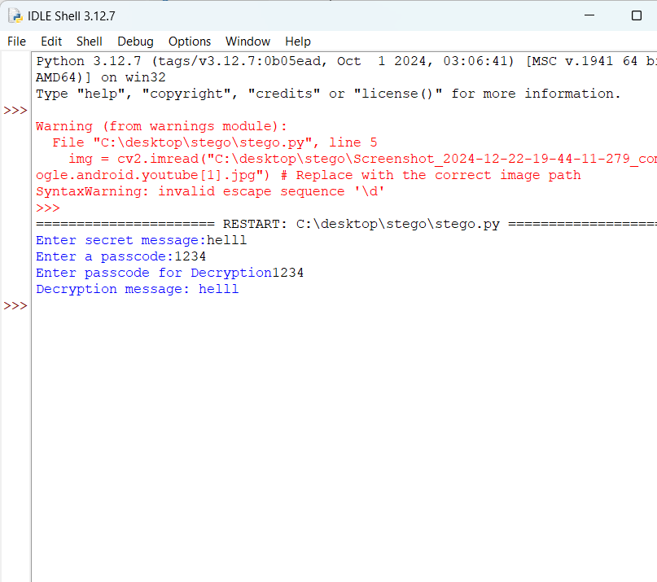
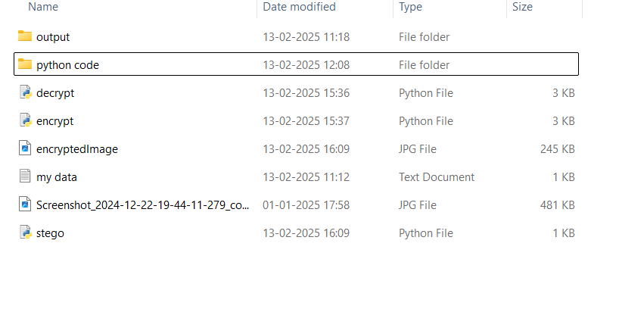
Results

Slide 8
Conclusion
In addressing the problem of secure data transmission, this project successfully demonstrates the use of steganography to hide sensitive information within images. By integrating robust encryption techniques with adaptive embedding algorithms, we ensure that the hidden data remains imperceptible to unauthorized users while preserving the quality of the carrier image. The user-friendly interface and multi-format support enhance the practicality and versatility of the solution. Ultimately, this project provides a secure, efficient, and innovative method for covert communication, protecting data integrity and confidentiality in the digital age.

Slide 9
GitHub Link
https://github.com/nddakshinamoorthy07/SECURE-DATA-HIDING-IN-IMAGES-USING-STEGANOGRAPHY.git

Slide 10
Future scope(optional)
The project of secure data hiding in images using steganography has significant potential for future advancements and applications. Here are a few areas to explore:
Enhanced Security Algorithms: Further development of more sophisticated and adaptive algorithms for embedding data to increase security and reduce detectability.
AI and Machine Learning: Incorporating AI and machine learning to automatically select optimal embedding points and detect potential threats or distortions in the carrier media.
Real-Time Applications: Extending the project to real-time communication platforms, allowing for secure, covert messaging over live chat and video streams.
Cross-Platform Integration: Developing cross-platform solutions to ensure seamless embedding and extraction of hidden data across various operating systems and devices.
Educational and Training Tools: Creating educational tools and resources to teach users and professionals about the principles and practices of steganography, enhancing awareness and skills in this field.

Slide 11
THANK YOU

